Slide 1
VIVEKANAND SEVA MANDAL DOMBIVLI (WEST)
NUTURING STUDENTS TO
LEARN,
GROW,
DEVELOP
& ACHIEVE GOALS

Slide 2
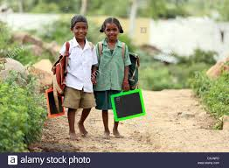
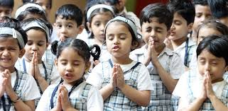
VIVEKANAND SEVA MANDAL DOMBIVLI (WEST)
NUTURING STUDENTS TO
LEARN,
GROW,
DEVELOP
& ACHIEVE GOALS

Slide 3
VIVEKANAND SEVA MANDAL DOMBIVLI (WEST)
INTRODUCTION
VIVEKANAND SEVA MANDAL WAS FOUNDED IN 1989 IN DOMBIVLI BY SHRI BALKRISHNA DAMODAR KUDE, RAMESH HARI KOTHAWADE & GANESH GOKUL CHINCHOLE.
VSM REGISTERED WITH CHARITY COMMISSIONER THANE IN THE YEAR 1990. THE REGISTRATION NUMBER IS F / 2620 / THANE /28-06-1990.

Slide 4
VIVEKANAND SEVA MANDAL DOMBIVLI (WEST)
SINCE LAST 27 YEARS, VSM HAS REACHED THOUSANDS OF NEEDY STUDENTS & HELPED THEM ECONOMICALLY TO ACHIEVE THEIR EDUCATIONAL GOALS & TO FULFIL THEIR DREAMS.
AREA COVERED IS JALGAON, DHULE & NASIK DISTRICT OF MAHARASHTRA.

Slide 5
VIVEKANAND SEVA MANDAL DOMBIVLI (WEST)
Presidents and their Tenure
Balkrishna D Kude : 1990-1995 & 1996 -2000
Prabhakar V Nerkar : 2001-2003
Pramod M Nerkar : 2004-2006
M J Amrutkar : 2007-2013
Ajit B Kude: 2014 – Till date

Slide 6
VIVEKANAND SEVA MANDAL DOMBIVLI (WEST)
OUR SCHEMES
DNYANESHWAR DATTAK PALAK YOJANA :
FOR STUDENTS PURSUING THEIR EDUCATION FROM 1ST TO 12TH STANDARD.
DRONACHARYA KARJAU SHISHYVRUTI YOJNA
REFUNDABLE SCHEME FOR STUDENTS PURSUING THEIR HIGHER EDUCATION 12TH ONWARD UPTO POST GRADUATION.
SARASWATI VISHESH SHAIKSHANIK MADAT YOJNA
SPECIAL SCHEME FOR STUDENTS WHO LOST THEIR PARENTS.

Slide 7
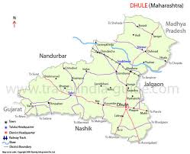
VIVEKANAND SEVA MANDAL DOMBIVLI (WEST)
2014-2017 TOUR OF VILLAGES
MALEGAON
ZODGE
ARVI
SHIRUR
DHULE
AMALNER
BAHADARUR
DHARANGAON
EARNDOL

Slide 8
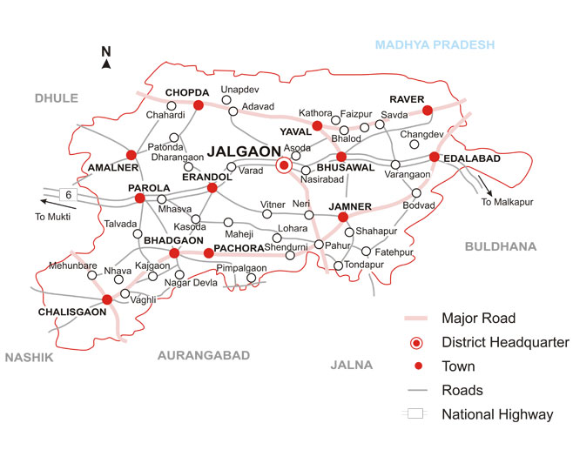
VIVEKANAND SEVA MANDAL DOMBIVLI (WEST)
2014-2017 TOUR OF VILLAGES
MEHUNBARE
CHALISGAON
PATONDA
RANJANGAON
KHEDGAON
GONDGAON
PAROLA
BHADGAON
PACHORA

Slide 9
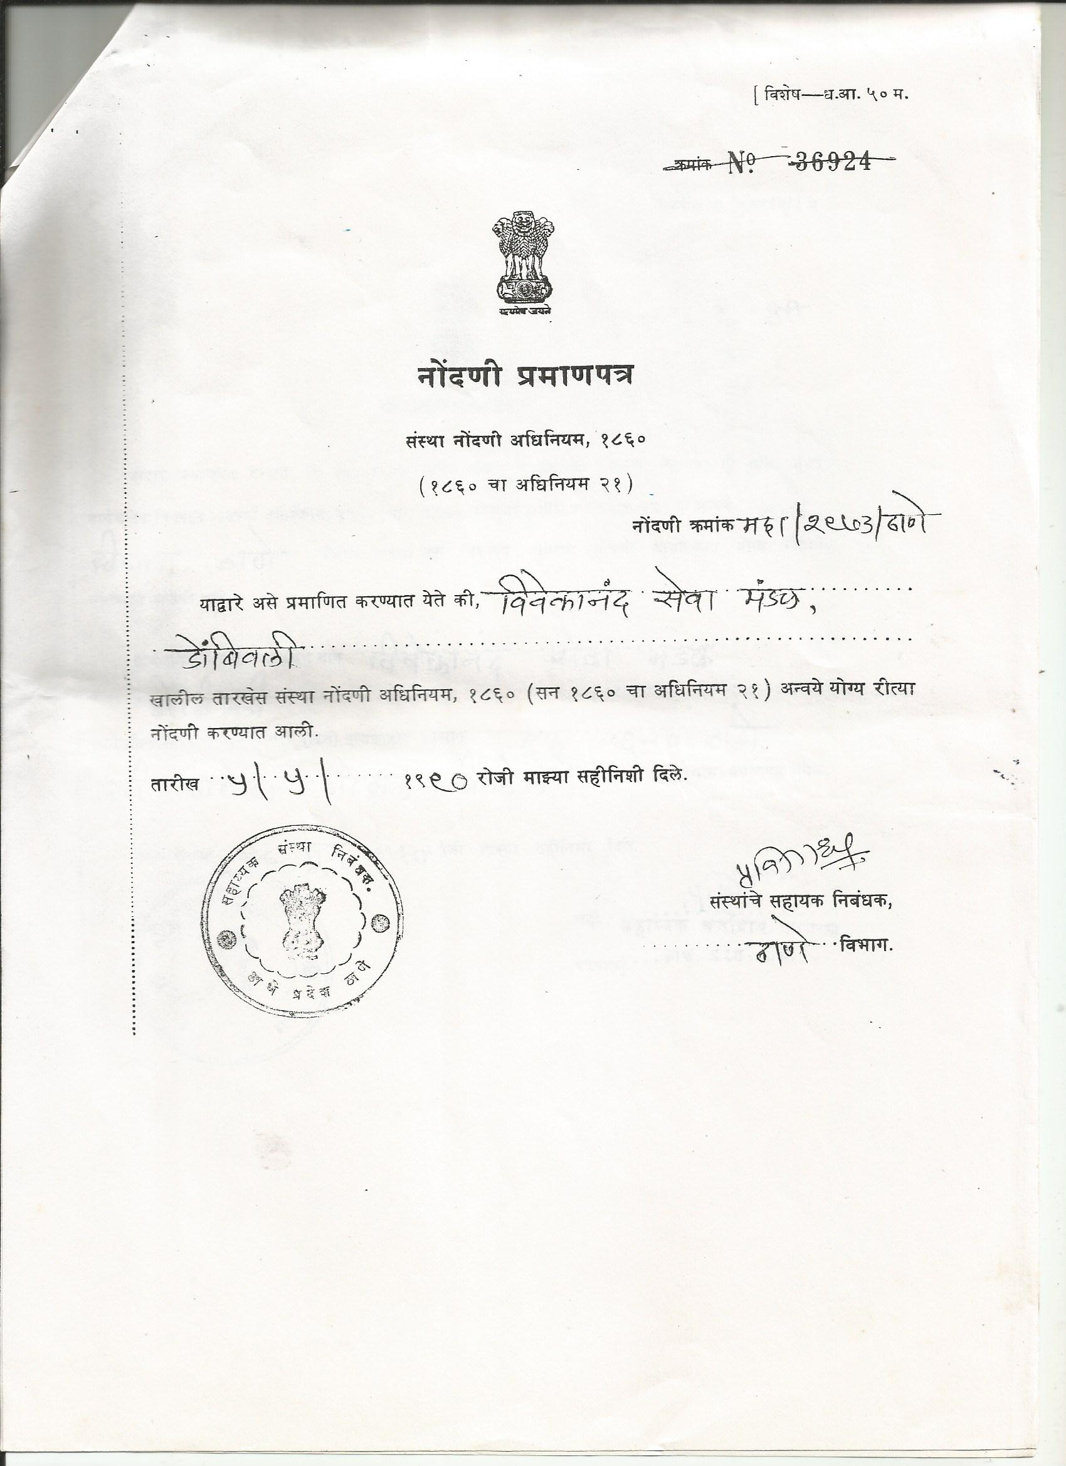
VIVEKANAND SEVA MANDAL DOMBIVLI (WEST)

Slide 10
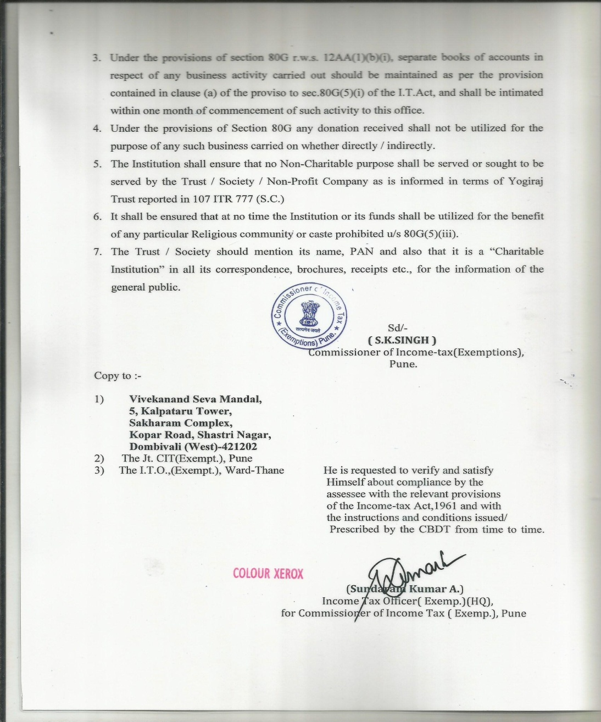
VIVEKANAND SEVA MANDAL DOMBIVLI (WEST)

Slide 11
VIVEKANAND SEVA MANDAL DOMBIVLI (WEST)
YEAR | LIFE MEMBERS | DONATIONS RECEIVED | NO OF STUDENTS | EDUCATIONAL AID DISTRIBUTED
2013-14
2014-15 |  | 172082 | 169 | 219061
2015-16 |  | 323282 | 138 | 239115
2016-17 |  | 590200 | 164 | 349500
2017-18

Slide 12
VIVEKANAND SEVA MANDAL DOMBIVLI (WEST)
2013-17 HIGHLIGHTS
ACTUAL VISIT TO VILLAGES, PERSONAL MEETINGS AND DISCUSSION WITH STUDENTS AND LOCAL SAMAJBANDHAV.
INCRAESED THE STRENGTH OF COMMITTEE MENMBERS FROM 7 TO 11 AND LIFE MEMBER FEE FROM RS 101 TO 1001
DISTRIBUTION OF FUNDS UNDER THREE VARIOUS SCHEMS, INRODUCTION OF SARASWATI SECHEM
ENTIRE FUND DISTRIBUTION BY CHEQUE / RTGS /NEFT
TIMELY SUBISSION OF INCOME TAX RETURNS .

Slide 13
VIVEKANAND SEVA MANDAL DOMBIVLI (WEST)
2013-17 HIGHLIGHTS
DISTRIBUTION OF DICTIONARY AND MOTIVATIONAL BOOKS DURING EVERY VISIT
VARIOUS SCHEMES FOR FUND COLLECTION LIKE DYANOSTAV 2016, DYANOSTAV 2017, FIXED DEPOSIT SCHEME
LIFETIME 80G CERTIFICATION FROM INCOME TAX DEPARTMENT

Slide 14
VIVEKANAND SEVA MANDAL DOMBIVLI (WEST)
YEAR | DRONACAHRYA YOJNA | SARASWATI YOJNA
 | Amount and Students | Amount and Students
2013-14
2014-15
2015-16
2016-17
2017-18

Slide 15
VIVEKANAND SEVA MANDAL DOMBIVLI (WEST)
HOW YOU CAN HELP, BE A PART OF NOBLE CAUSE
BY DIRECT DONATIONS
BY DONATING INTEREST ON YOUR SPECIIFIED INVESTMENTS
BY DONATING AMOUNT ON SPECIAL OCCASIONS LIKE BITRHDAYS & ANNIVERSARIS.
BY DONATING AMOUNT IN THE MEMORY OF YOUR BELOVED.
BY DONATING THE DAKSHINA DURING GANESHOSTSAV & NAVARATRI ,SATYANARYAN POOJA
BY SPONSORING THE EDUCATIONAL STUDY MATERIAL / BOOKS / EQUIPMENTS /OTHERS

Slide 16
VIVEKANAND SEVA MANDAL DOMBIVLI (WEST)
YOU CAN SPONSOR THE ENTIRE SCHEME (YOJNA)
THE NAME OF SCHME WILL BE THE NAME YOU WISH,
SHRI A.B.WANI DRONACHRYA KARJAU SHISHYVRUTI YOJNA.
“THIS NAME WILL BE THEIR FOR LIFETIME”
THE DONATION AMOUNT IS
RS. 11,00,000

Slide 17
VIVEKANAND SEVA MANDAL DOMBIVLI (WEST)
Mr. Ajit Balkrishna Kude – 09322519823
Mr. Rajendra Ganesh Sinkar – 09930261717
Mr. Vinod Murlidhar Sinkar – 08879114421
Mr. Sachin Subhash Wani – 07738214795
Mr. Prashant Narayan Pakhale – 09969153224
Mr. Namdeo Dattatraya Shende- 09892219736
Mr. Amol Shamkant Shirode – 09867932787
Mr. Atul Dattatraya Metkar – 09892445657
Mr. Pravin Pundlik Pakhale – 9423916305
Mr. Ashok Hari Yeole -09004357306
Mr. Parag Madhukar Tipre - 09029103076

Slide 18
VIVEKANAND SEVA MANDAL DOMBIVLI (WEST)
OUR ADVISORS
SHRI BALKRISHNA KUDE, RAMESH KOTHAWADE, M D NERKAR
Our MAIL ID
vivekanandasevamandal@gmail.com
Our BANK DETAILS
Bank : IDBI Bank Limited
Branch: Dombivli East, Ram Nagar Branch
Account Number: 0669104000164559
IFSC Code: IBKL0000669
MICR Code: 400259065

Slide 19
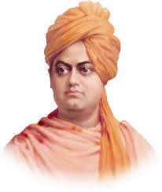
VIVEKANAND SEVA MANDAL DOMBIVLI (WEST)
DONATE GENEROUSLY
ITS OUR COMMUNITY SOCIAL RESPONSIBILTY
YOUR DONATION
WILL COPLETE THE DREAM OF EDUCATION

